Slide 1
Airline Sentiment Analysis
Lola Jackson

Slide 2
About
This Build project references airline tweets from 6 different airlines and uses statistical methods to analyze general sentiment about each airline and make predictions using trained models.

Slide 3
Exploratory Data Analysis (EDA)
Examine and characterize the data in order to find its underlying characteristics, possible outliers, and hidden patterns and relationships between variables. ​

Slide 4
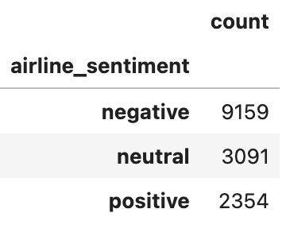
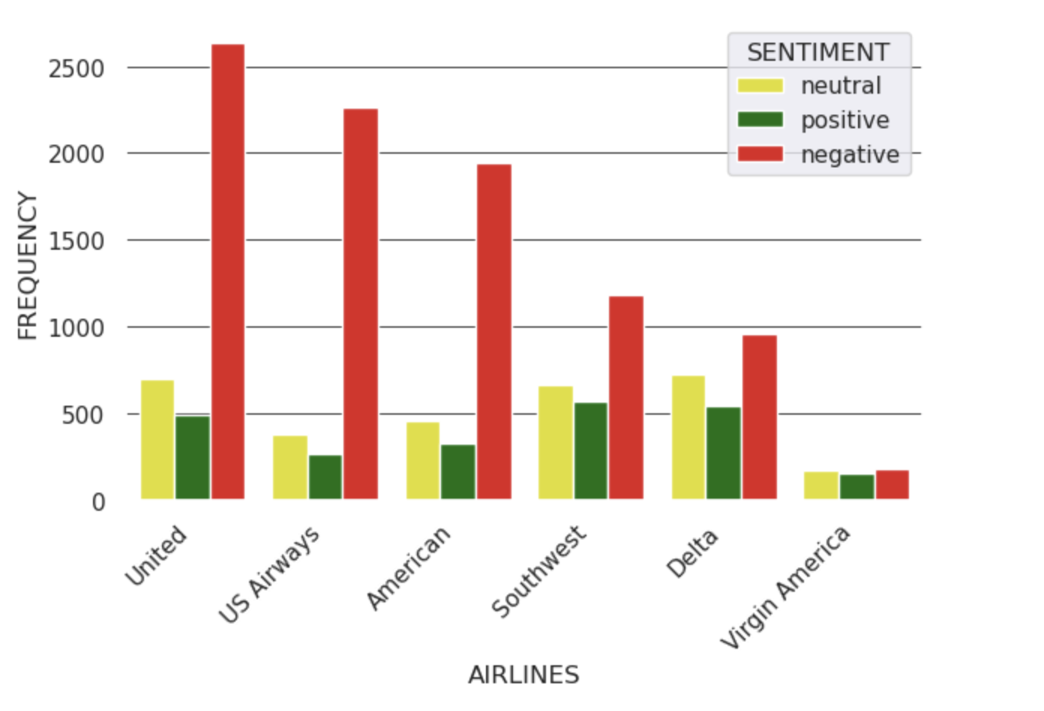
Data Overview
General sentiment is overwhelmingly negative for each airline with the exception of Virgin Airlines. One should note however, that Virgin also has the least amount of overall tweets. This could point to fewer flights or fewer customers who use twitter. One should also note that because people will often complain online about negative experiences, will influence the bias in the dataset.

Slide 5
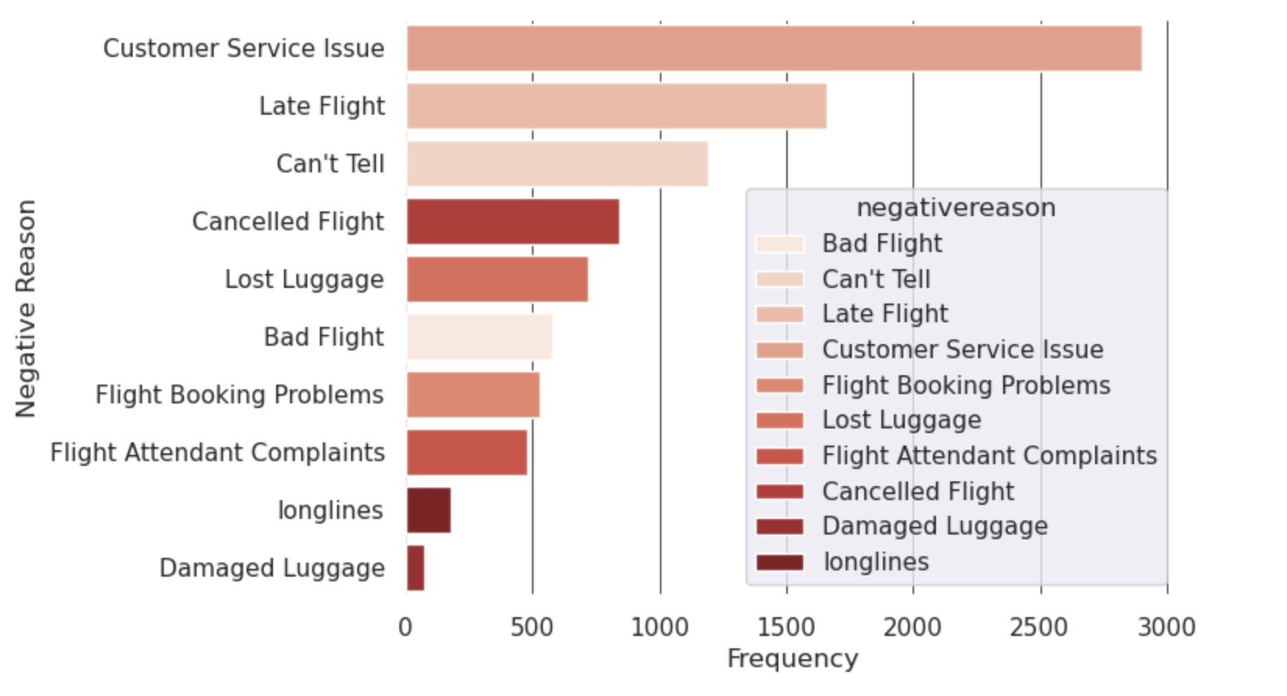
Across all six airlines, the biggest complaints amongst customers seems to be general customer service issues and flight delays.

Slide 6
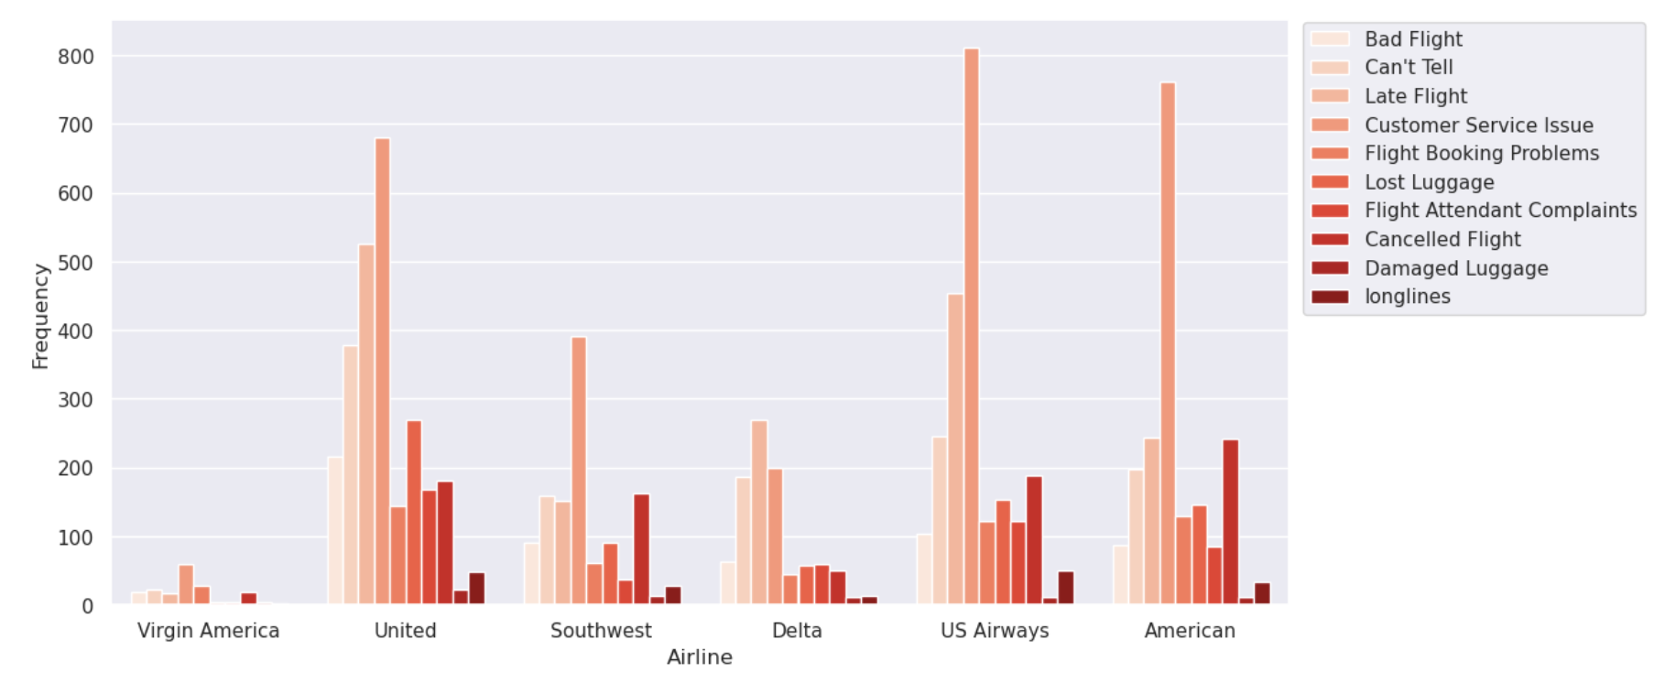
A closer look at the data shows consistency amongst all airlines having the biggest issue with customer bookings.

Slide 7
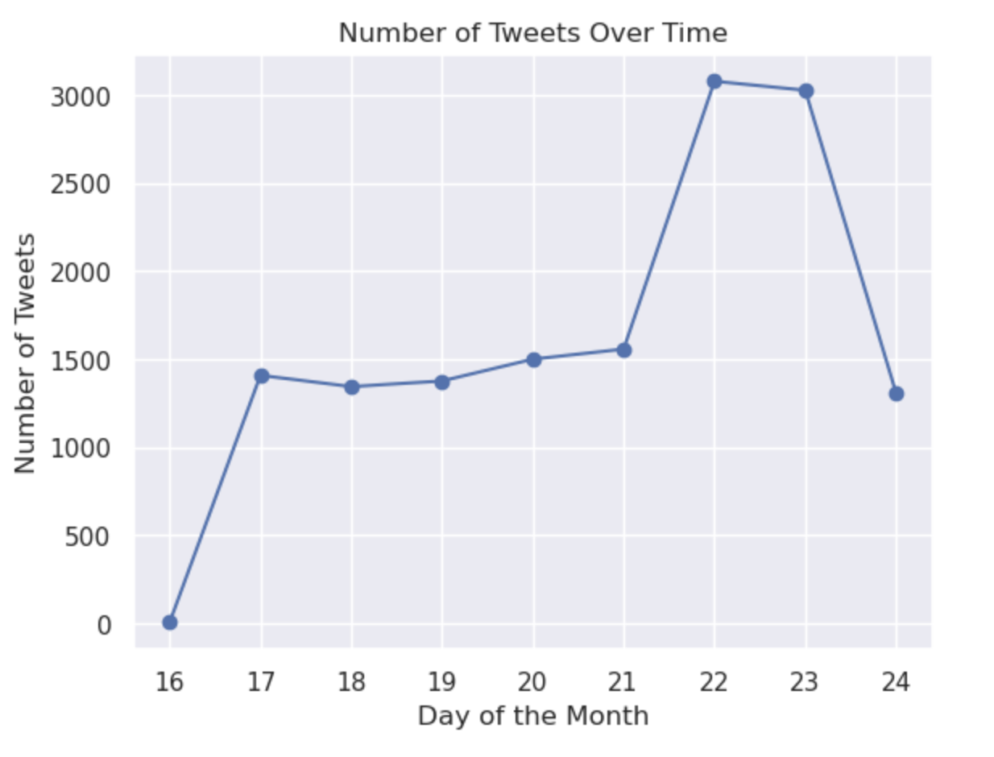
The dataset includes tweets made over a brief period of time - relatively 7 days - from February 16-24, 2015. This graph shows the most number of tweets on the Sunday of the 22nd suggesting that most people tweet over the weekend.

Slide 8
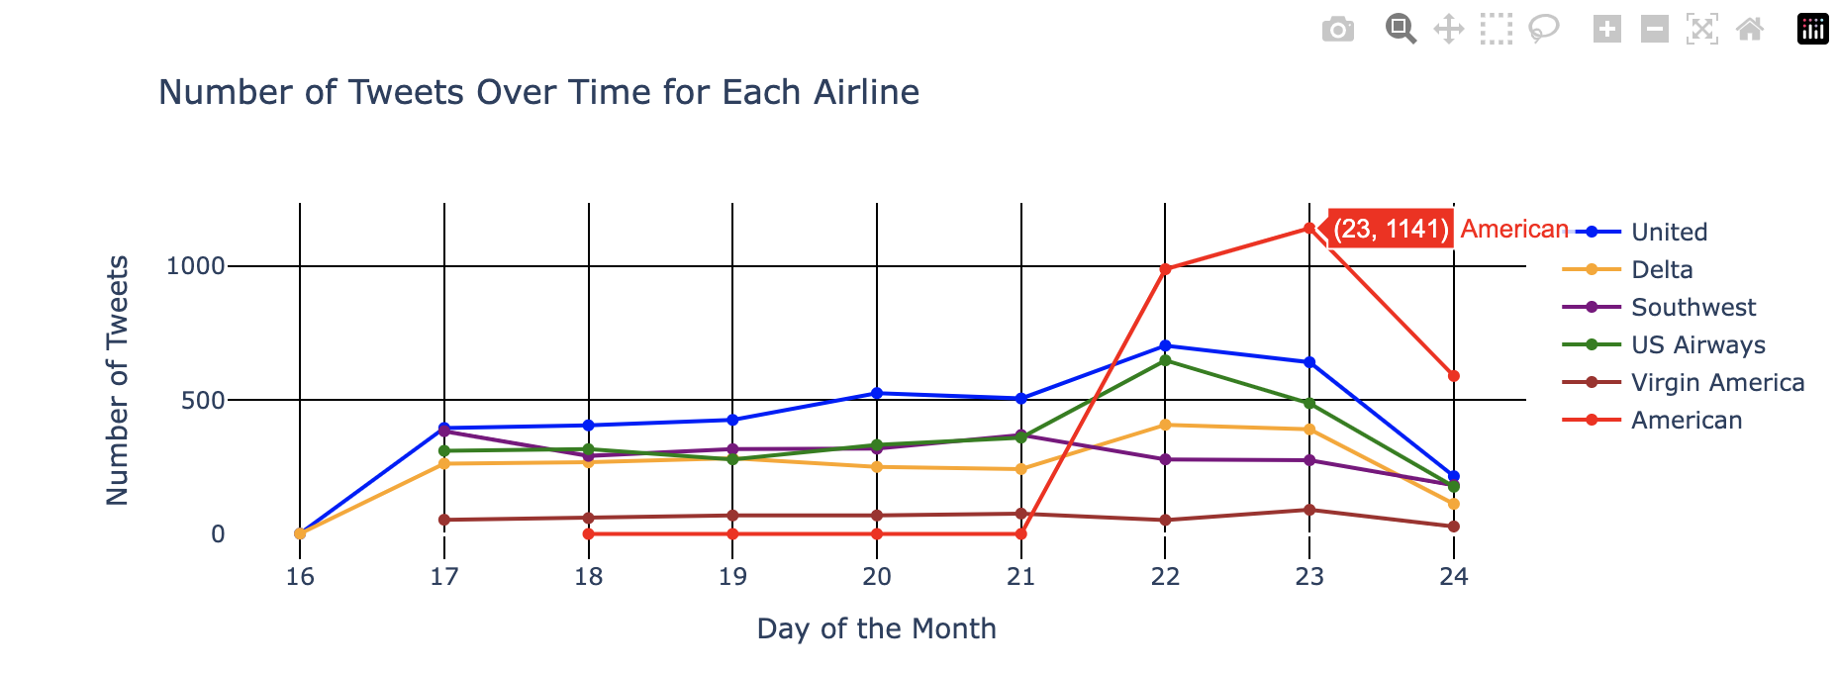
A closer examination of the data shows a significant proportion of the tweets focusing on American Airlines. Interestingly, Southwest is the only airline with declining tweet mentions over the weekend.

Slide 9
Text and Natural Language Processing
In order to prepare our data for training, it is necessary to process the unstructured text data to be used efficiently.
The purpose of this process is to enhance the the quality and usability of the text data for subsequent analysis or modeling.
This process involves cleaning and trimming the data using a number of different techniques

Slide 10
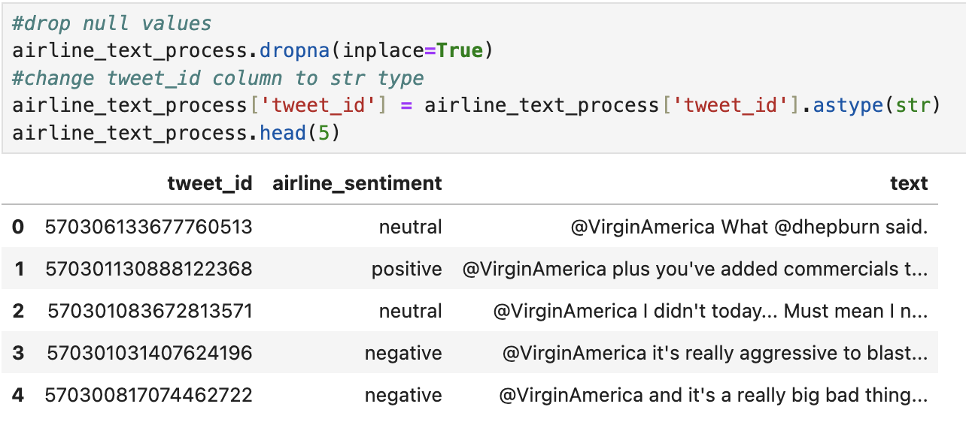
During my process, I removed the NaN values. This helps to “clean” the data by removing any missing or invalid entries in the dataset.

Slide 11
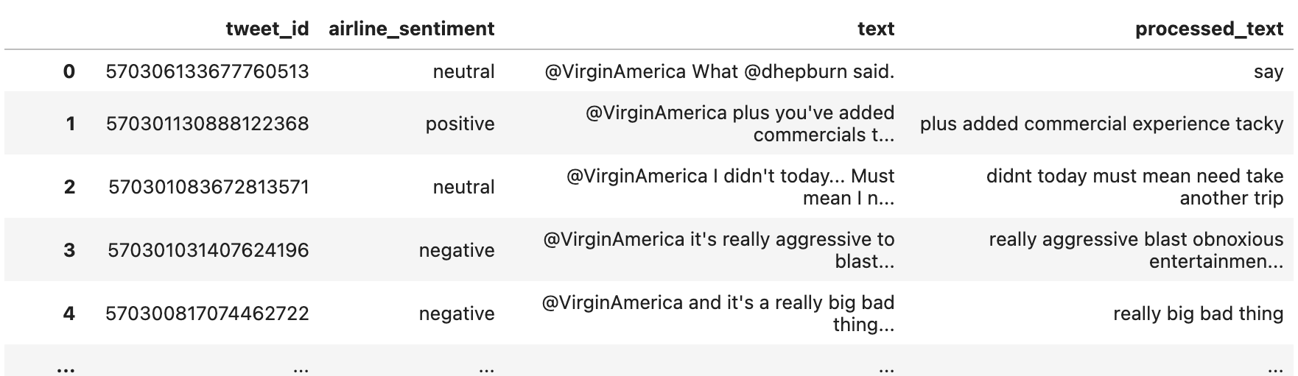
A lemmatization function was used to parse through each tweet and remove any “messy” information such as numbers, punctuation, emojis and other non-ASCII characters, as well as stop words to distill the data to a format suitable for the machine learning process.

Slide 12
Feature Engineering and Sentiment Analysis
In order to extract meaningful information from the raw data to make it usable for machine learning models, we need to transform our text into numeric representation for computer processing.

Slide 13
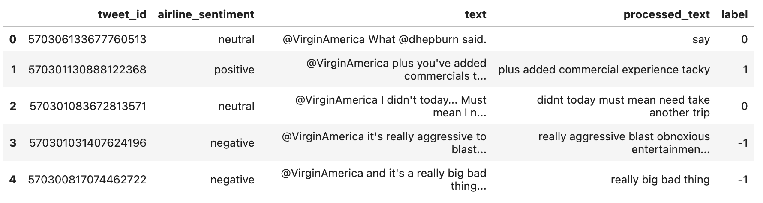
This table shows how airline sentiment can be represented numerically using 1, -1, 0 for positive, negative and neutral sentiment respectively.

Slide 14
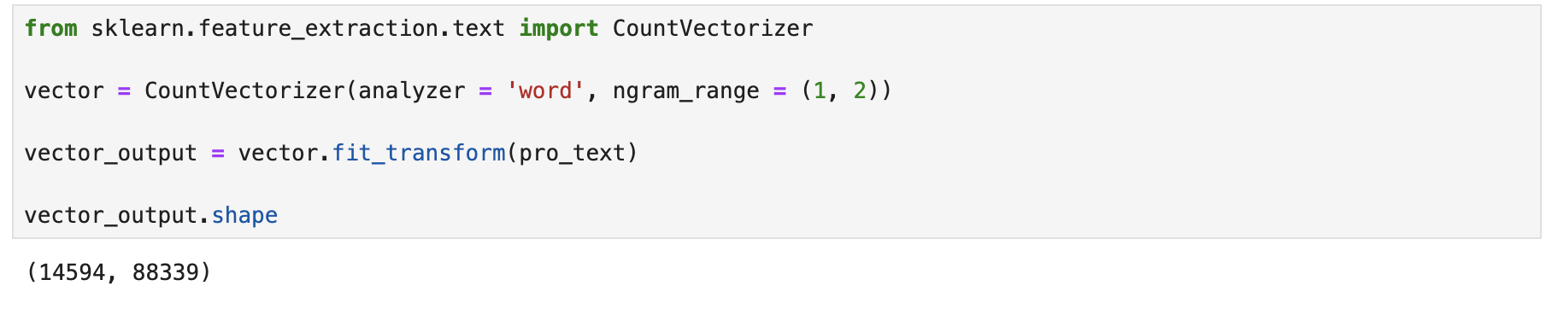
This project utilizes the bag of words technique to vectorize the text into a matrix of token counts (Ngrams). This number shows the total number of documents(rows) to unique unigrams and bigrams(columns).

Slide 15
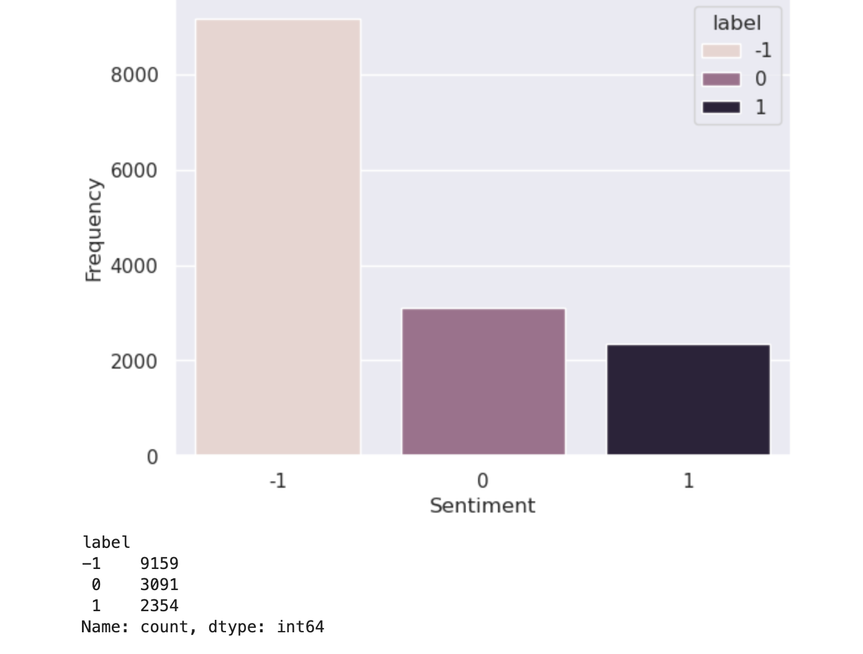
Data Balancing
Data Balancing is necessary when the information is heavily skewed. The original dataset shows a bias towards negative sentiment.

Slide 16
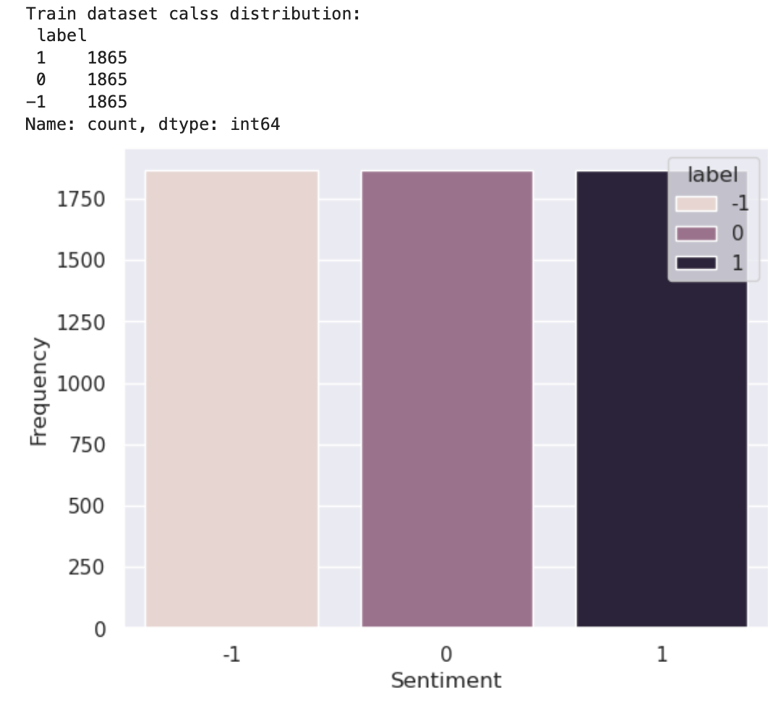
Because of the overwhelming negative sentiment, undersampling was used to rebalance the data by removing samples from the majority class.

Slide 17
Model Exploration, Development and Classification
The data was trained using the Supervised Machine Learning method and various Classification methods were explored and analyzed for accuracy:
Naive Bayes
Gradient Boosting
Decision Trees
Random Forest
K-Nearest Neighbors

Slide 18
Overall Performance:
Decision Tree (DT) and Random Forest (RF) consistently performed the best across all configurations, with F1 scores mostly in the 0.68-0.78 range.
Naive Bayes (NB) and K-Nearest Neighbors (KNN) consistently underperformed compared to the other algorithms.
Gradient Boosting (GB) showed good performance, especially in weighted F1 scores.

Slide 19
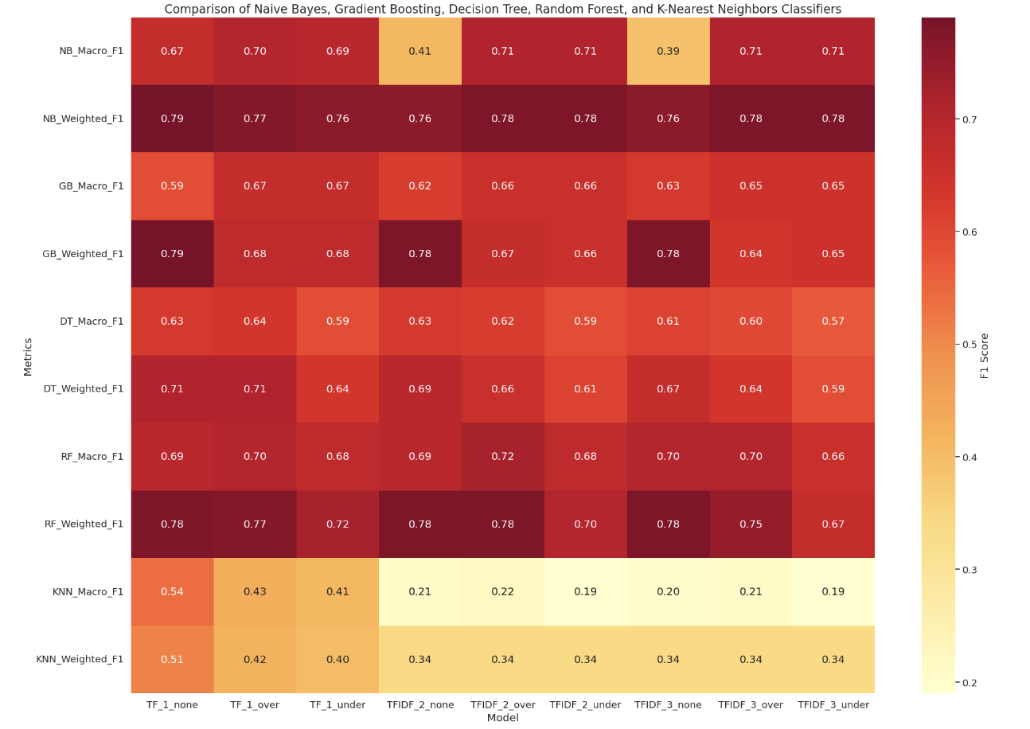

Slide 20
Conclusion
Nearly each classifier method responded differently depending on the hyperparameters given.
The Naive Bayes model performed with higher accuracy in macro F1 scores when a larger ngram values were used with a sampling method, versus the weighted F1 scores which scored the highest overall the other modeling methods but had less significance between the hyperparameters given.
Similarly, the Random Forest model performed the second best in weighted F1 scores with also a weak significance between each parameter. This model also took the longest to process, as it created 100 decision trees for each inference instance.
Surprisingly, the K-Nearest Neighbors classifier model was the least accurate in both the macro and weighted F1 scores, with the nearest neighbor value having little impact over accuracy.
Overall, the Naive Bayes and Random Forest models are the best for handling the data given, but Random Forest might perform better with smaller, incomplete datasets and Naive Bayes for larger amounts of information.

Slide 21
Conclusion
Picking the right algorithm makes the biggest impact on data accuracy. Based on my findings, the N-gram range and difference in performance between TF and IDF were ambiguous.
The heatmap reveals that ensemble methods (Random Forest and Gradient Boosting) and Decision Trees are the most effective for this classification task. They perform well across different feature extraction methods and are somewhat robust to sampling techniques. The simpler models (Naive Bayes and K-Nearest Neighbors) struggle with this dataset, suggesting the problem may be too complex for these algorithms.

